Slide 1
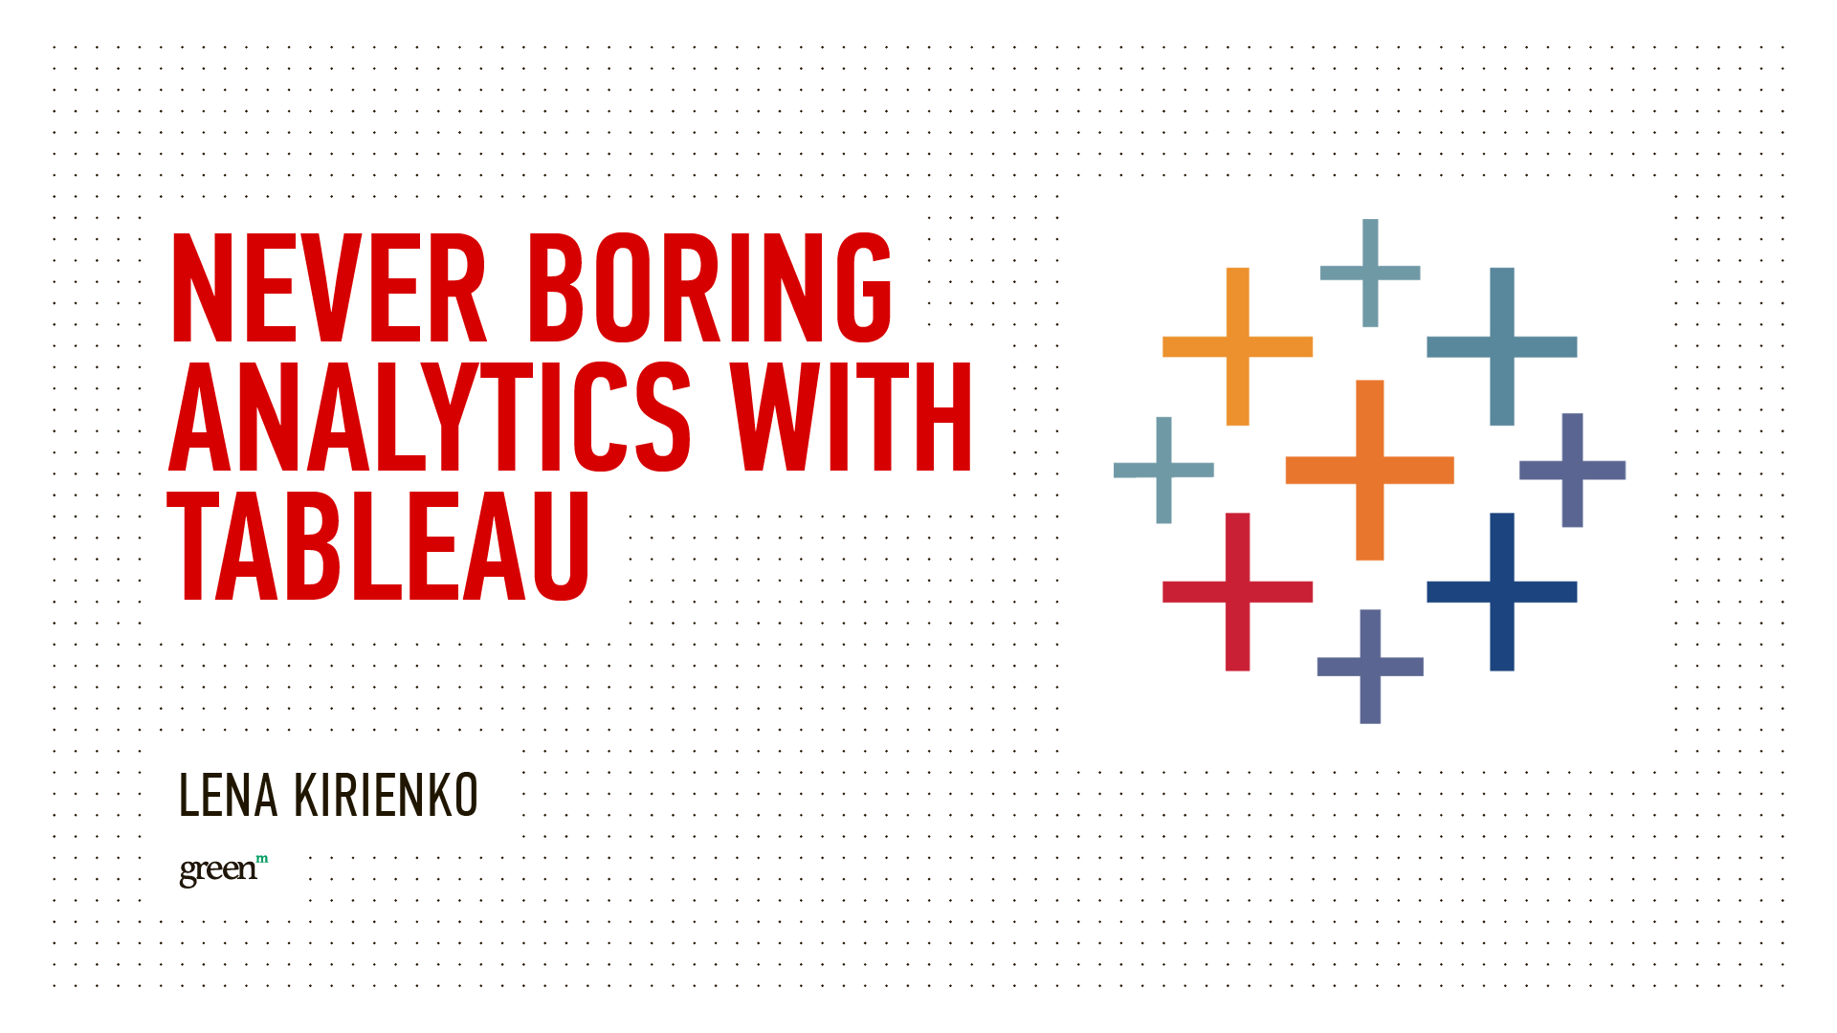

Slide 2
OVERVIEW
Good Visualization – what does it mean
What is Tableau good for
What is Tableau not good for and how we deal with that
Performance

Slide 3

VISUALIZATION DESIGN
What’s my goal?
Who is my audience?

Slide 4
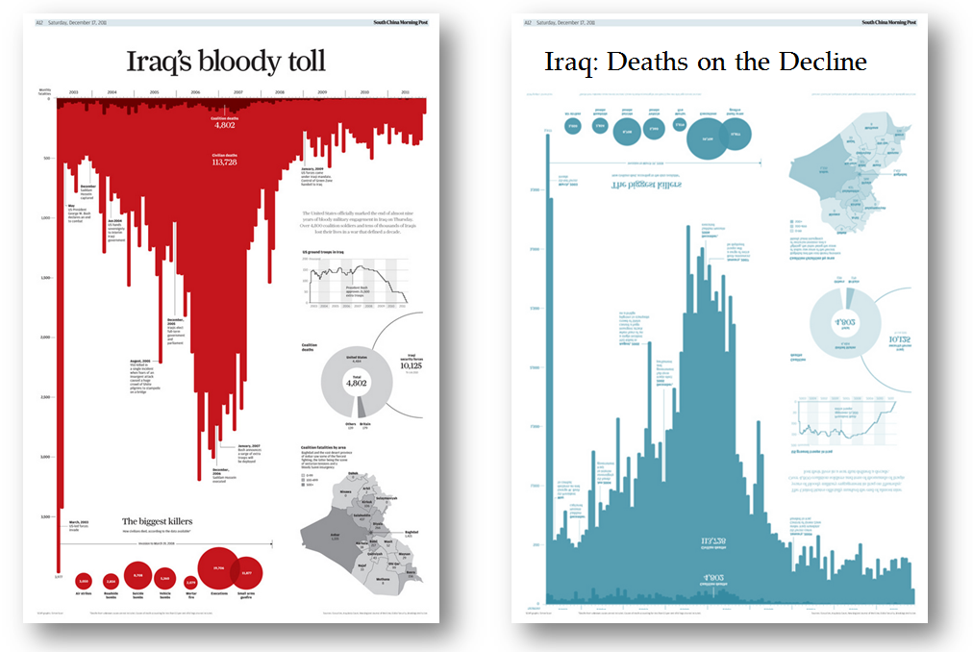
MAKE A STORY

Slide 5
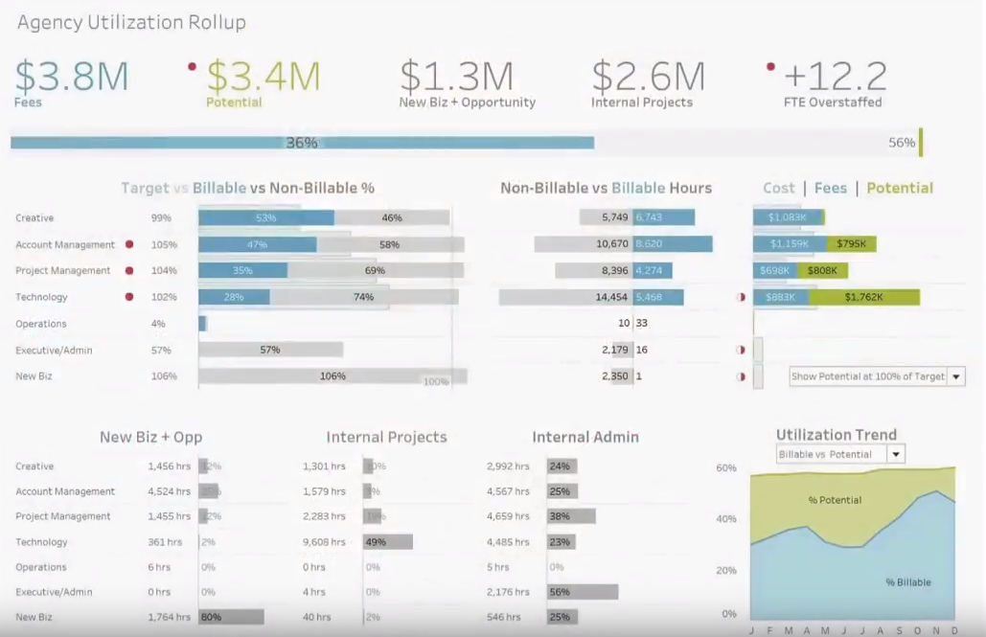
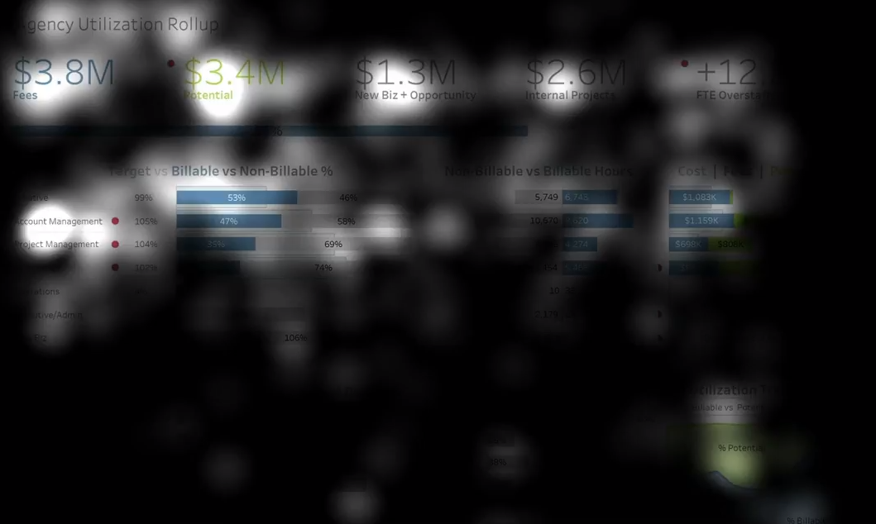
EYE TRACKING

Slide 6
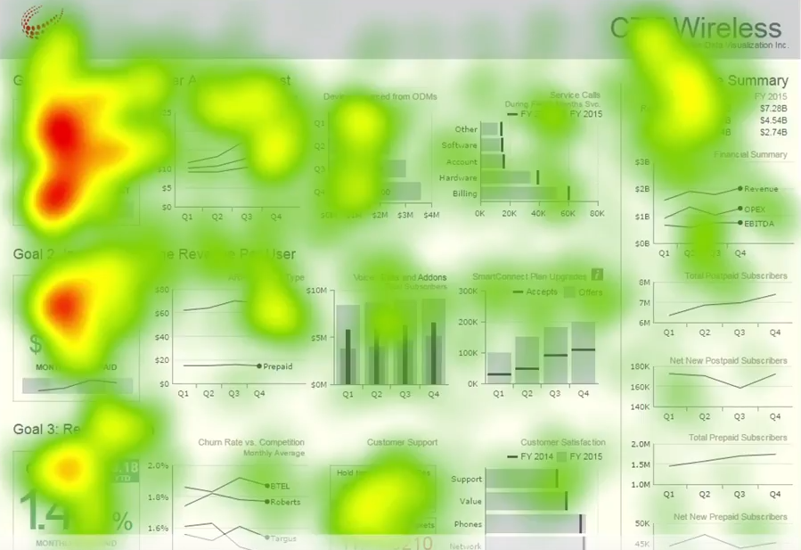
EYE TRACKING
Big numbers
Medium or Large font
The focus – top left corner

Slide 7
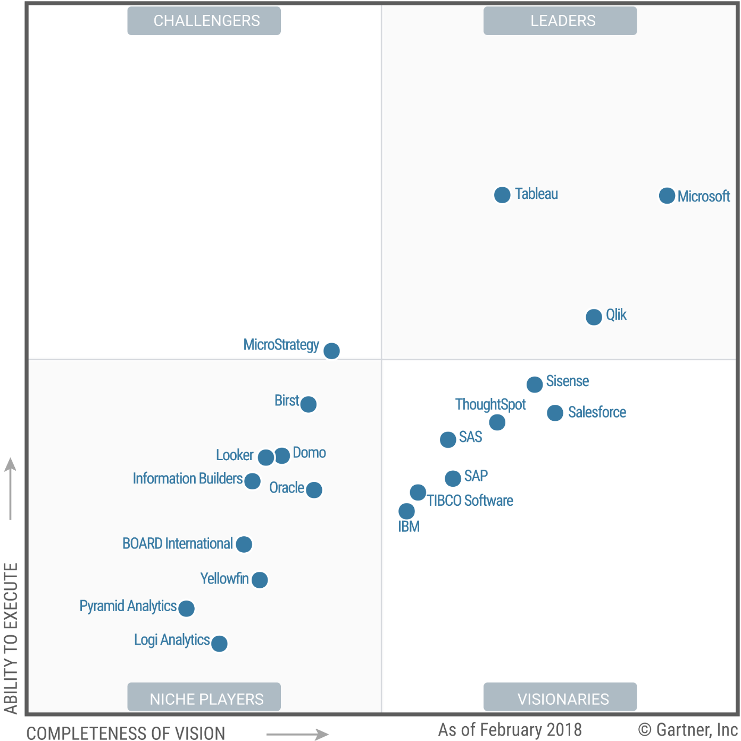
GARTNER BI MAGIC QUADRANT

Slide 8
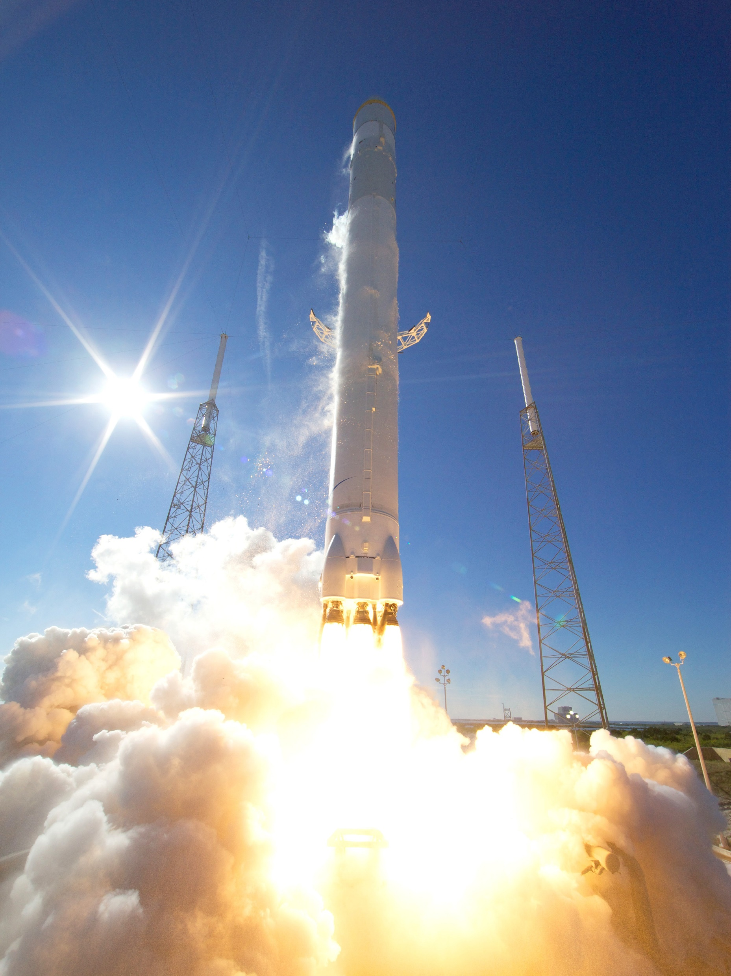
WHAT IS TABLEAU GOOD FOR?

Slide 9
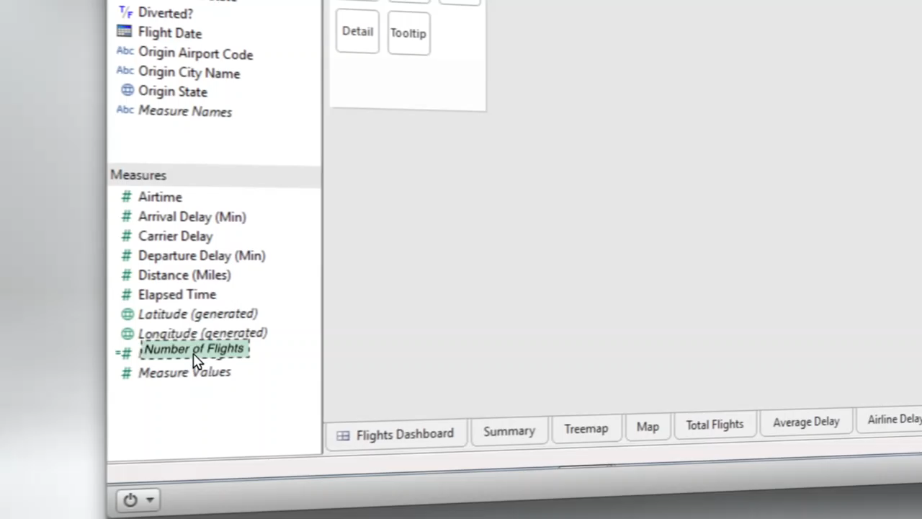

Slide 10
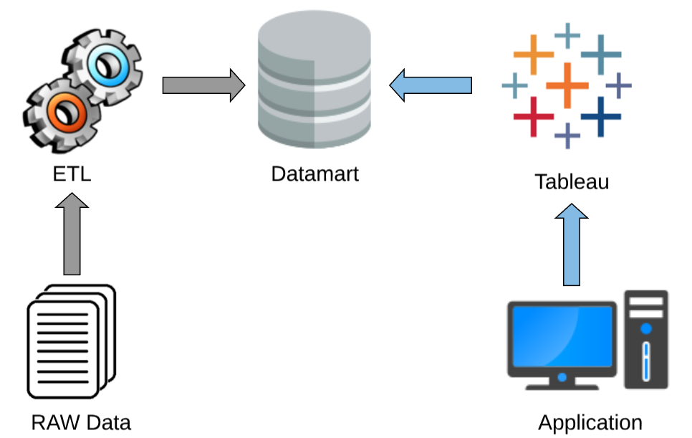
HOW WE USE TABLEAU?
Tableau embedded into custom Portal
Datamart is build via ETL
Vertica database as a source
Live connection
~100 million records

Slide 11
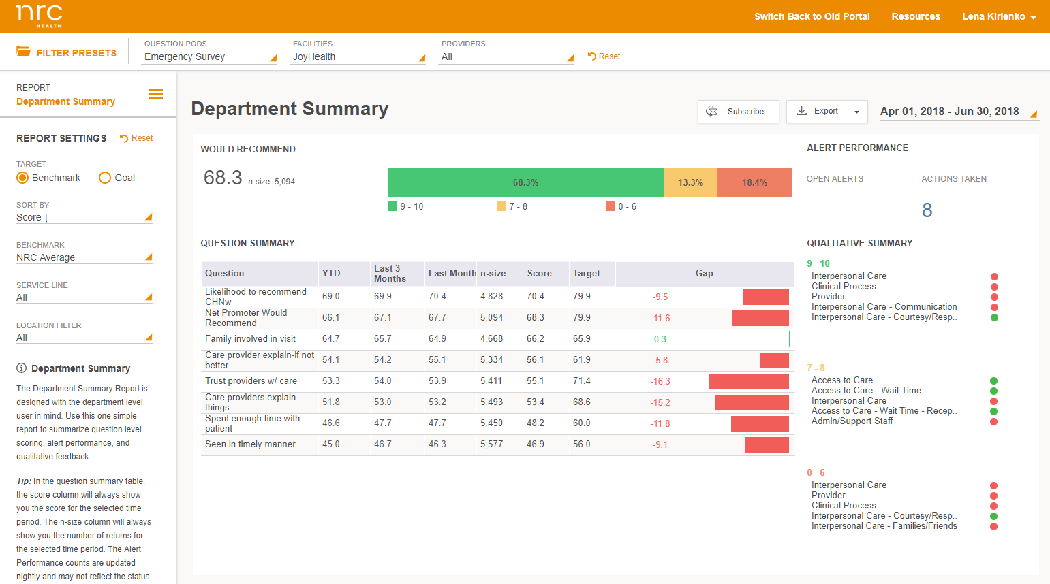
HOW WE USE TABLEAU?

Slide 12
HOW WE USE TABLEAU?
Custom portal
Custom portal
Tableau Embed

Slide 13

WHAT IS TABLEAU NOT GOOD FOR?

Slide 14
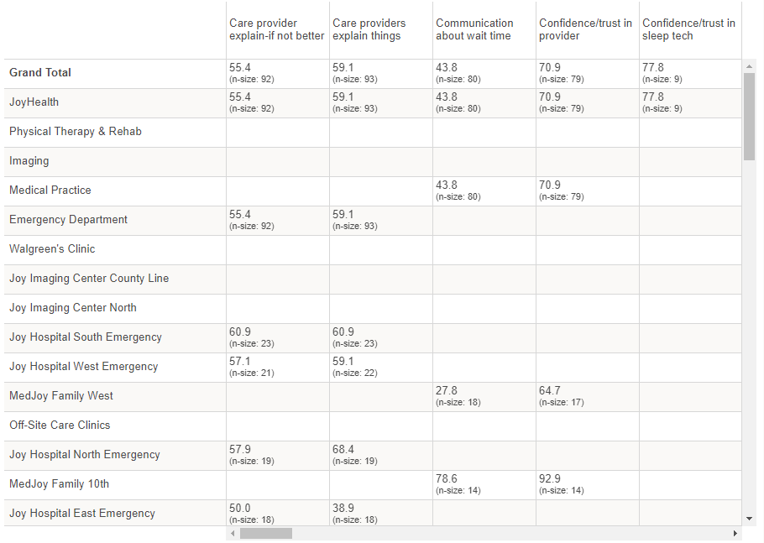
TABLEAU IS NOT A TABLE TOOL
If it is the main output you need
If you expect good performance for large tables
Result:
Simple table without advantages
Performance might be a ?

Slide 15
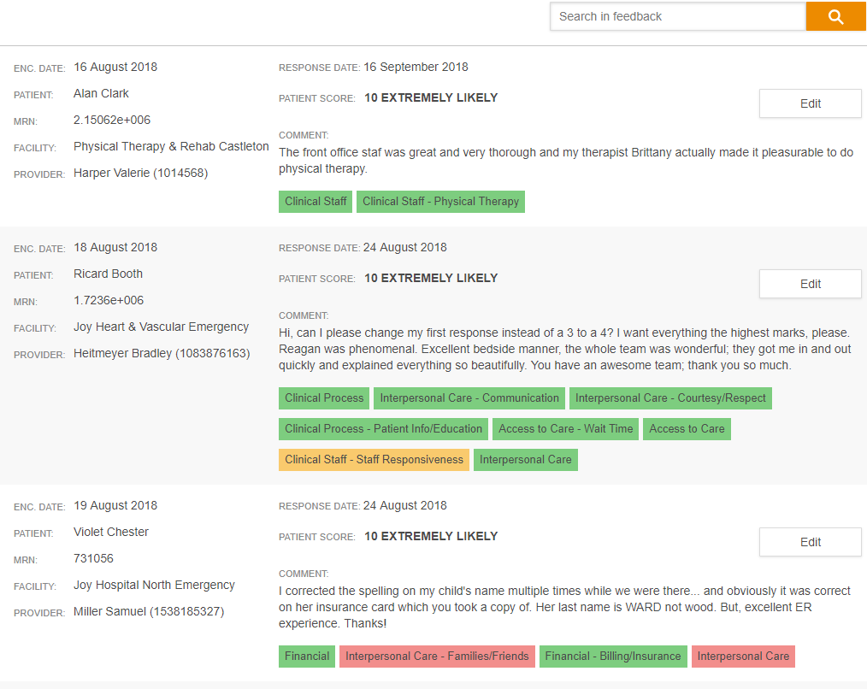
ALTERNATIVE WAY
Use Exports instead of live reports
Create your own table (not a Tableau)
Not a Tableau

Slide 16
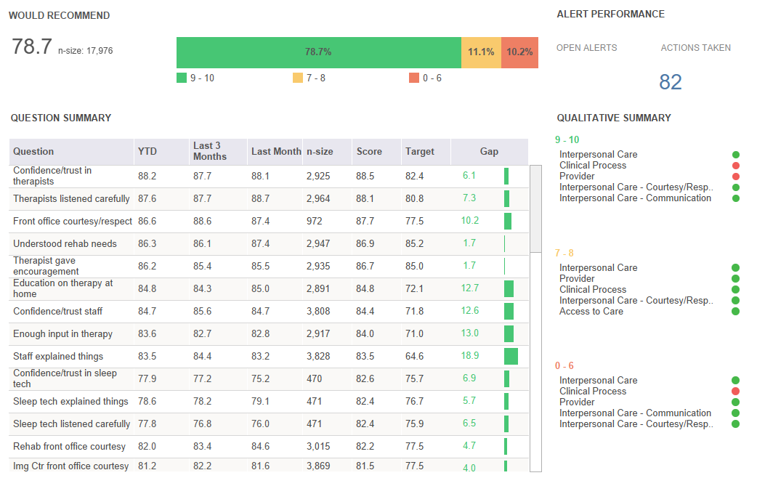
EXPORTS
Tableau exports are not customized
CSV – includes extra data that is more technical
Dashboards with several charts and scrolls – couldn’t be exported in full size

Slide 17
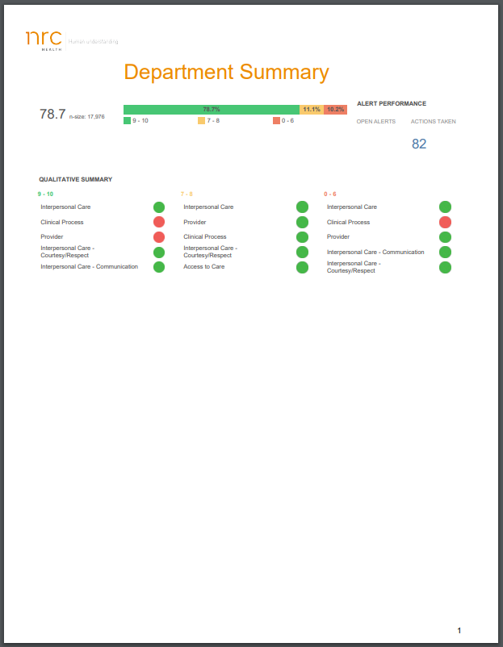
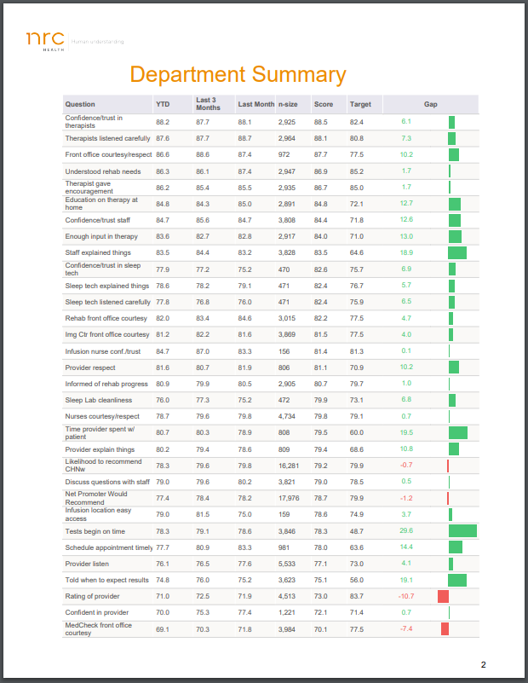
ALTERNATIVE WAY
Use Tableau export as a separate views using API
Use http://www.pdfsharp.net
for combining
Add logo, header, paging…

Slide 18
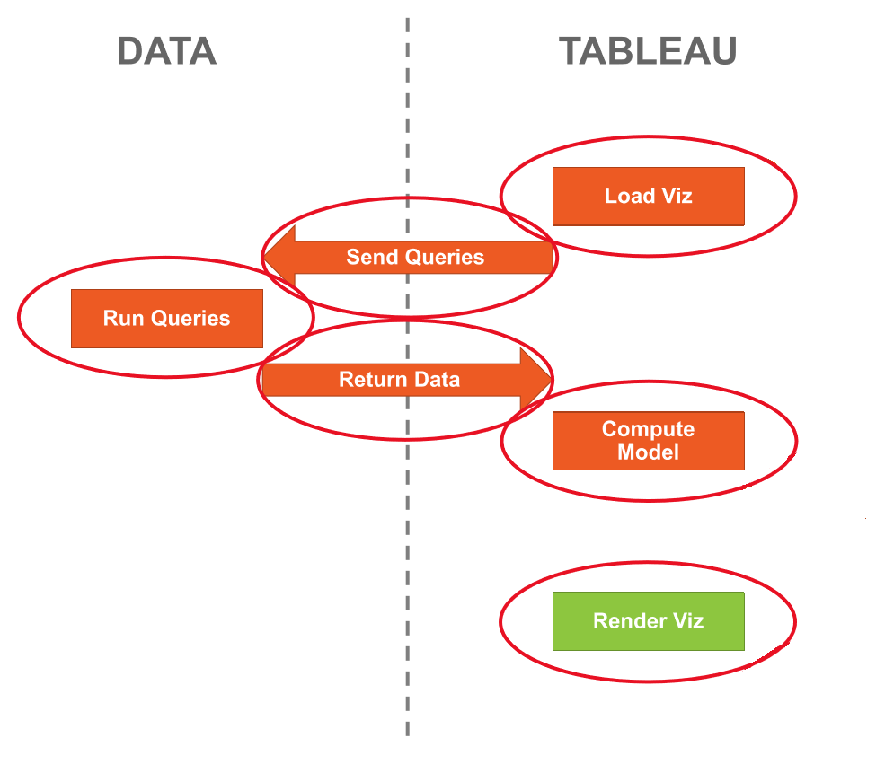
PERFORMANCE IS IMPACTED BY

Slide 19
PERFORMANCE PYRAMID
It all starts with workbook design
Minimize # of views and filters
Reduce # of marks on the view
Simplify visualization
Distinct Count is Distinct Count
Rewrite calculation or change granularity of your data
Use external functions
Influence queries that Tableau send
Optimize query plan on DB side
Enlarge instance size (concurrency)
Use extract/cache if possible
Workbook design
Calculations
Queries
Data
Env

Slide 20
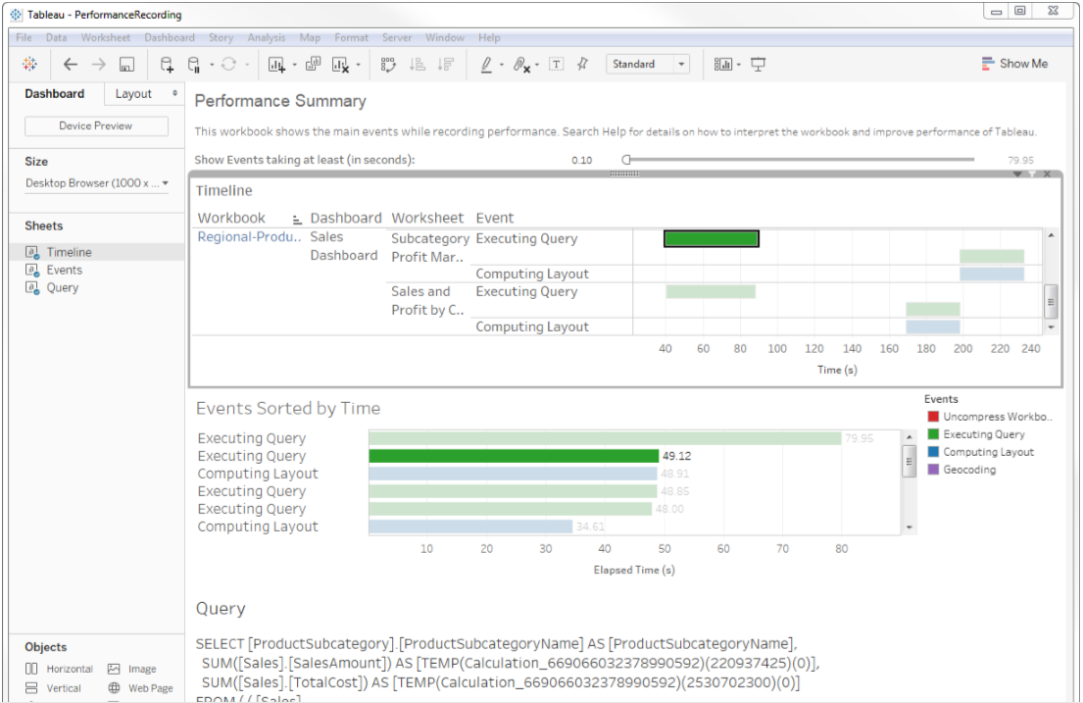
OPTIMIZATION
Use Performance recorder
Available for both Tableau Desktop and Tableau Server
Actual timeline of internal events
Computing layouts
Connecting to data source
Executing query
Generating extract
Geocoding
Blending data
Server rendering

Slide 21

THANK YOU!
LENA KIRIENKO
Senior Business Analyst
at GreenM
lkirienko@greenm.io

